Slide 1
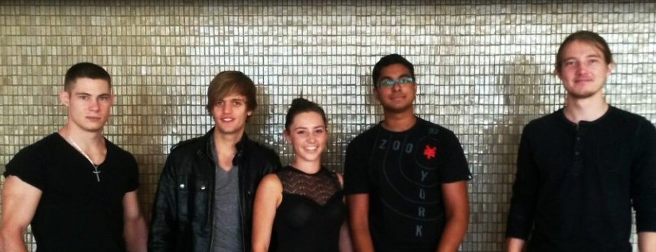
Team Eclectic
Project Linphone-Waterfall

Slide 2


The Client
The Client 2.0
Kobus Coetzee

Slide 3

Local Storage
DataExchangeFormat Interface
Database CRUD

Slide 4

Encryption
Key Exchange Complete
AES Message Encryption Complete

Slide 5

Communication
Group Chat Protocol
Group-Chat-ID
Group-Message-Type
Administration
Messages
Invites – 3 Stages for AES256
Token Holder

Slide 6

Front-End
Finalization of Activity and Fragment:
Transactions
Activation
Navigation
Minor unforeseen changes to documentation
Android Development
Core integration

Slide 7

Documentation
User Interface Layout Complete
Final Documentation
User Manual
ATP – Acceptance Test Procedure
Usability Documentation

Slide 8


Timeline
SRS
PSAC
SDD
Coding
Testing & ATP
Final Documentation
Completed 30th May
Completed 27th June
Completed 22nd July
Finishing up
Current Phase
Current Phase

Slide 9

Thank You

